Slide 1
Pollution prediction using LSTM
Supervisor: Dr. Isam Al Jawarneh
Group’s members:
Madyan Omar Ibrahim Bagosher
Fatemeh Mohammadi Aghjehmashhad

Slide 2
Contents:
Some information about the data
Correlation Matrix
Correlation Coefficients
Data preparation
Machine Learning approach
Prediction using LSTM

Slide 3
Some Information about the data:
We used two distinct datasets: one in CSV format detailing pollution levels across New York City, and another as a GeoJSON file outlining the city's map.
The number of records: 169,999
The data was covered from 2021-09-10 at 12:29:09 to 2021-12-15 at 14:35:55
which makes 96 days and 02:06:46.
The maximum pollution value : 12.74
The minimum pollution value: 1.57

Slide 4
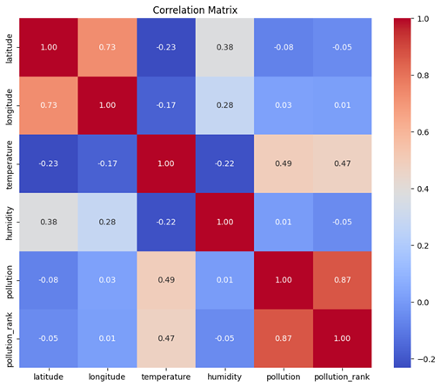
Correlation Matrix: The correlation coefficient measures the strength and direction of the linear relationship between two variables. We calculated the correlation matrix for the features of our data such as (pollution, pollution rank, humidity, temperature, longitude and latitude). In general: -Darker red shows stronger positive correlations. -Darker blue shows stronger negative correlations. -Lighter colors (closer to white) indicate moderate correlations (closer to zero). From the image on the right, among other observations, we can see that: 1) Temperature and Pollution: Temperature exhibits the strongest positive correlation with pollution among the variables, recorded at 0.49. This suggests that higher temperatures might be associated with increased pollution levels. 2) Humidity and Pollution: Humidity shows a negligible positive correlation with pollution, noted as 0.01. This indicates that there is virtually no linear relationship between humidity levels and the overall pollution levels, suggesting that factors other than humidity play a more significant role in influencing pollution.

Slide 5
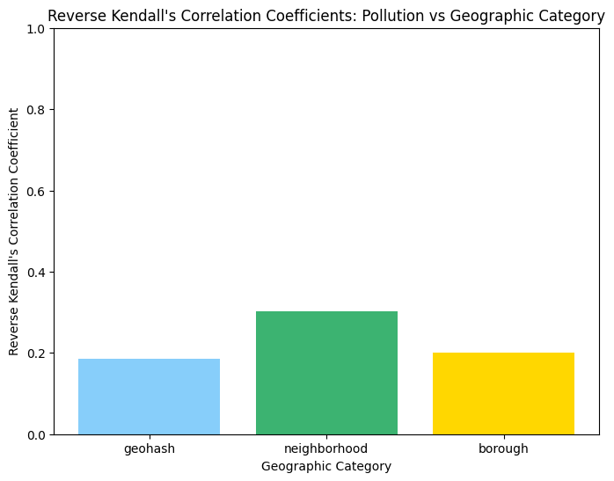
CORRELATION COEFFICIENTS 1) Reverse Kendall's correlation coefficient We use Reverse Kendall's correlation coefficient to find the association between the average rank of “pollution” values and the size of each geographic category. Geohash: Correlation Coefficient: ~0.18 This value indicates the weakest correlation between pollution levels and the geohash category, suggesting that geohash does not align as closely with factors that influences pollution levels. Neighborhood: Correlation Coefficient: ~0.35 The neighborhood category shows a much higher correlation with pollution levels, indicating a strong relationship. Larger neighborhoods, which likely correlate with higher population density or more intense urban activities, tend to have higher pollution levels. Borough: Correlation Coefficient: ~0.2 Borough are larger geographic categories than neighborhoods. Although, it has variations in pollution levels, but these variations are less distinct than those observed at the neighborhood level.

Slide 6
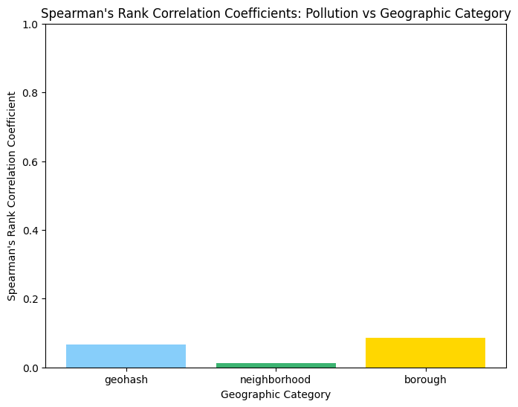
2) Spearman's Rank Correlation Coefficient This measures the strength and direction of association between the rank of geographical categories ( 'geohash’, “neighborhood “ and “borough”) and 'pollution’. It is suitable when the relationship is monotonic but not necessarily linear. Test Hypothesis: Null Hypothesis (H0): There is no monotonic relationship between the geographic location and the pollution levels. H1: There is a monotonic relation between the geographic location and the pollution levels. Our results: P-values: • Geohash vs Pollution: 4.454497640901313e-166 • Neighborhood vs. Pollution: 1.5984415142310416e-06 • Borough vs. Pollution: 4.068933168365492e-277 Overall there is generally a weak association between the ranks of geographic categorizations (geohash, neighborhood, and borough) and pollution.

Slide 7
3) ANOVA (Analysis of Variance) ANOVA, or Analysis of Variance, is a statistical method used to analyze the differences among means of three or more groups. We are facing with the following Hypothesis: H_0: All group means are equal. H_1: At least one group mean is different. We got the following ANOVA test results for ‘neighborhood’ (respectively, “borough” and 'geohash') and ‘pollution’: • Neighborhood - F-statistic: 194.2967984990712, P-value: 0.0 • Borough - F-statistic: 1571.4452929273557, P-value: 0.0 • Geohash - F-statistic: 3520.2944091142294, P-value: 0.0 Conclusion: The P-value is zero, so we reject H_0. This implies that the pollution levels vary significantly across different geographic scales (geohash, borough, and neighborhood). The F-statistic for geohash is the highest (3520.2944091142294) which indicates a strong spatial variability in pollution distribution between geohash groups.

Slide 8
4) Kruskal-Wallis Test The Kruskal-Wallis test is a method used to determine if there are statistically significant differences between the medians of two or more independent groups. It is especially useful when the assumptions required for ANOVA test are not met, such as when the data are not normally distributed or when the groups have unequal variances. Test Hypothesis: H_0: The medians of pollution levels of different groups are equal. H_1: There are significant differences in the medians of pollution levels between the groups defined by neighborhood, borough, and geohash. The Kruskal-Wallis test results for “neighborhood “ (respectively, “geohash” and “borough”) and 'pollution’ are as follow: • Neighborhood: Statistic = 3194.7088275131123, P-value = 0.0 • Borough: Statistic = 1281.6427998977276, P-value = 3.178456778603967e-276 • Geohash: Statistic = 752.7255492814534, P-value = 1.025109961523071e-165 Conclusion: In all cases, the extremely small P-values indicate that the results are statistically significant, allowing us to reject the null hypothesis.

Slide 9
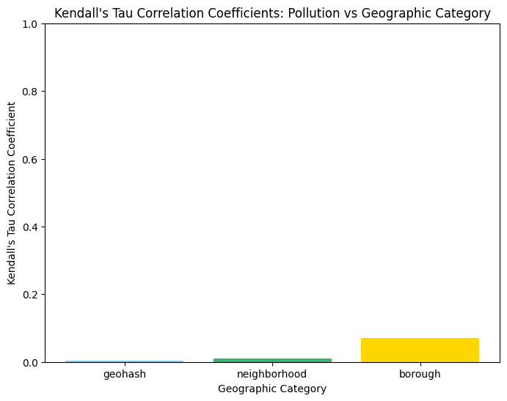
5) Kendall's Tau Correlation Coefficient This measures the strength and direction of association between the ranks of 'geohash’ (respectively, ‘borough’ and ‘neighborhood') and 'pollution’. It is suitable measure when the relationship is not necessarily linear. For two categories “neighborhood” and “geohash” the correlation is very close to zero but positive, suggesting a very weak direct relationship between geohash rank (res. neighborhood) and pollution levels. The association between borough and pollution is higher than the others, however still is a small value. • For neighborhood: Correlation = 0.009259718338660744, • For borough: Correlation = 0.07034127731459229 • For geohash Precision: Correlation= 0.0024383698700505266,

Slide 10
Data preparation
The dataset consisted of two separate files that we merged through a geospatial join operation. The files contained 31 features relating to the air conditions in New York and Geo spatial data that contained locations within New York. Upon performing the join operation and dropping some features that did not contain relevant information, we ended up with 10 features.
Latitude, Longitude, Temperature, Humidity, Neighborhood, Borough,
Borough Code, Timestamp, Geohash, Pollution (Particulate Matter 2.5)
We only utilized 5 features to train our model: Latitude, Longitude, Temperature, Humidity and the target variable is Particulate matter 2.5.

Slide 11
Machine Learning approach
We used a couple of machine learning algorithms to attempt to forecast pollution levels in New York. Although, machine learning, specifically regressive based algorithms performs well at forecasting. Our two models:
Linear Regression Model
Support Vector Regression
Did not perform as well as the other models and neural networks that we later trained. This is because these algorithms perform well with simpler data that have linear relationships, is not suited for sequential data handling and does not retain information over long sequences.

Slide 12
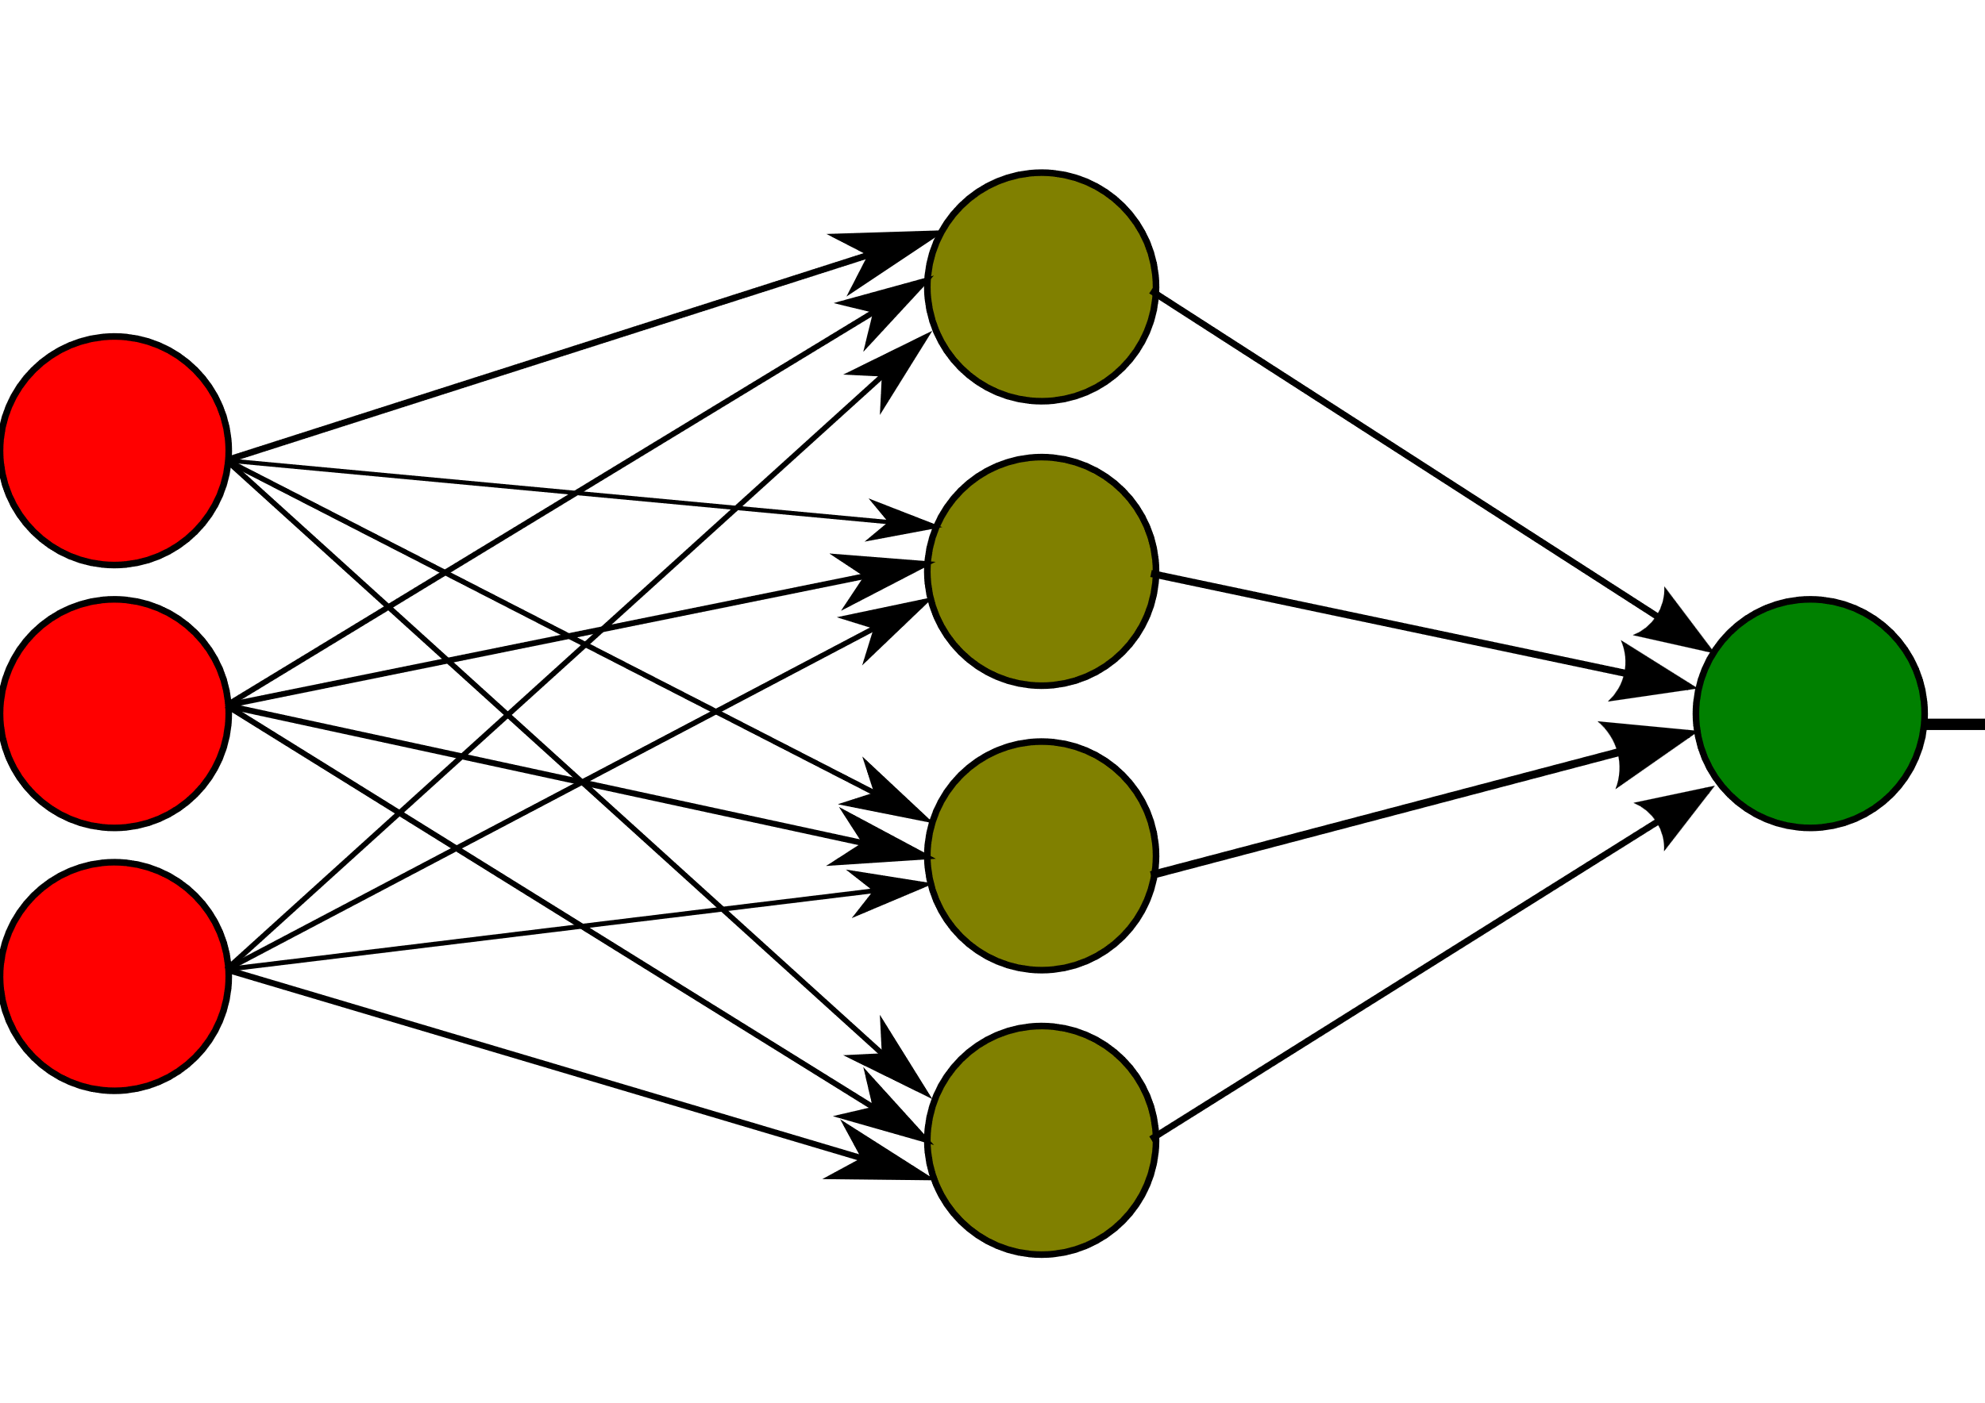
Multi Layer perceptron (MLP)
A Multi-Layer Perceptron (MLP) is a type of artificial neural network that consists of multiple layers of nodes (neurons), including an input layer, one or more hidden layers, and an output layer. Each node in one layer is connected to every node in the subsequent layer, and each connection has an associated weight that is adjusted during the training process.
Although, neural networks perform well in capturing complex relationships between various factors influencing air quality. It does not perform as well as other networks in dealing with sequential data and forecasting tasks.

Slide 13
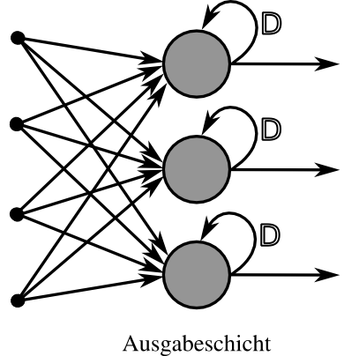
RNN Network
Recurrent Neural Networks (RNNs) are a type of artificial neural network designed to handle sequential data by capturing temporal dependencies. They have been successfully applied to various sequential prediction tasks, including time series forecasting, natural language processing, and speech recognition.
Though, they perform well in dealing with sequential prediction tasks, they suffer from capturing long term dependencies within the data, suffering from an issue known as the ‘vanishing gradient problem’.

Slide 14
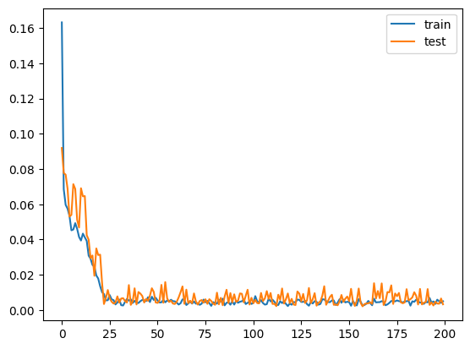
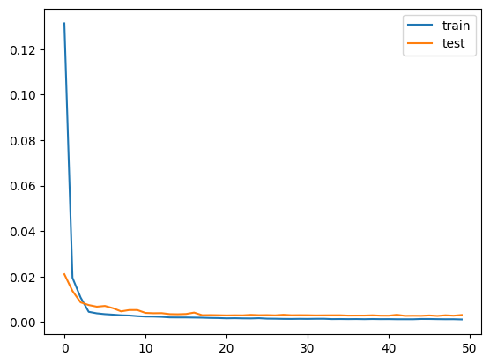
Prediction using LSTM
Our proposed and final model is the LSTM model which solves the ‘vanishing gradient problem’ by capturing long term dependencies and performs well with sequential data and forecasting tasks.
The model was constructed with 4 units (Memory Cells) and trained over 50 epochs with a batch size of 32. We used these parameters to counter an overfitting issue that we encountered with previous parameters. On the right are 2 graphs demonstrating the training process, using MAE loss and Adam optimizer. The first one is the overfitted graph and the second one is the improved model’s graph.
The model once evaluated, performed well. We managed to obtain an accuracy of 70.63%, a root mean squared error of 0.001 and mean absolute error of 0.00020.

Slide 15
Benchmarking our models and networks.
Model | MAE | MSE | RMSE | Max prediction error | Accuracy
LSTM | 0.00060 | 0.00000 | 0.001 | 0.088 | 70.63
MLP | 0.16276 | 0.05552 | 0.236 | 0.793 | 58.90
RNN | 0.00069 | 0.00000 | 0.001 | 0.097 | 67.37
SVR | 0.00722 | 0.00008 | 0.009 | 0.060 | 40.04
LR | 0.00011 | 0.00000 | 0.004 | 0.097 | 49.00

Slide 16
Thank you

